Slide 1
Notes:
Many thanks to David and We Are Ament for inviting me.

Slide 2
Notes:
With the recent and upcoming change to 3rd party cookie we are facing an issue. Personalization is not going to be as easy or possibly even possible in the coming years. So today I am going talk about a different concept that can work cross platform.

Slide 3
Notes:
My name is Martin Mccully, I am creative consultant and designer, today I’m going to talk about how relevancy in creative can significantly help brands, in optimizing their campaigns helping mitigating the upcoming cookie problem. I’m going to share some of the knowledge I gain while I was the Global Design director for Liveposter, which is Dentsu Agency & Platform specializing in Dynamic Digital DOOH. During my role I worked on over 500 campaigns for the world’s largest brands using real time data, social feeds, user generated content and brands own business data. We pioneered the use of relevancy in OOH creative for our clients.

Slide 4
Notes:
The right story, the right product, the right brand the right deal, it’s the most relevant content. This is a fundament shift to traditional thinking and for some tradionaists the hardest concept for many to grasp. Technology is now mature enough across the media landscape to lets us change out creative, our offer, or the content our customers see. Going from a generic catch all that has to appeal to everyone, to a targeted and more relevant one that can be as specific for a singe person.
It’s the relevancy that’s is the key to effectiveness. Th level of data now available to brands about their customers means we can create real data driven insights, based on real customers
If we make it more relevant then our consumers engage more, remember our brands and messages more and buy more of our product and key to this statement is that we have the research & results backs this up.
Creating relevant messaging across multiple media channels by listening to and anticipating customer needs, mood or mindsets.
It focuses on current events, trends, or feedback.
It harnesses the power of data to deliver amazing, dynamic campaigns.
Deployment of effective campaigns at the right time, in the right place and at scale.

Slide 5
Notes:
JC DECAUX, CLEAR CHANNEL & POSTERSCOPE 2020 “The Moments of Truth” report by Neuro-Insight
NOTE: Brain activity NEURO SCIENCE SECTION, this studied the effects on the participants brain activity. When more relevant content was shown the brain activity was significantly increased over the levels when only linea content was shown.

Slide 6
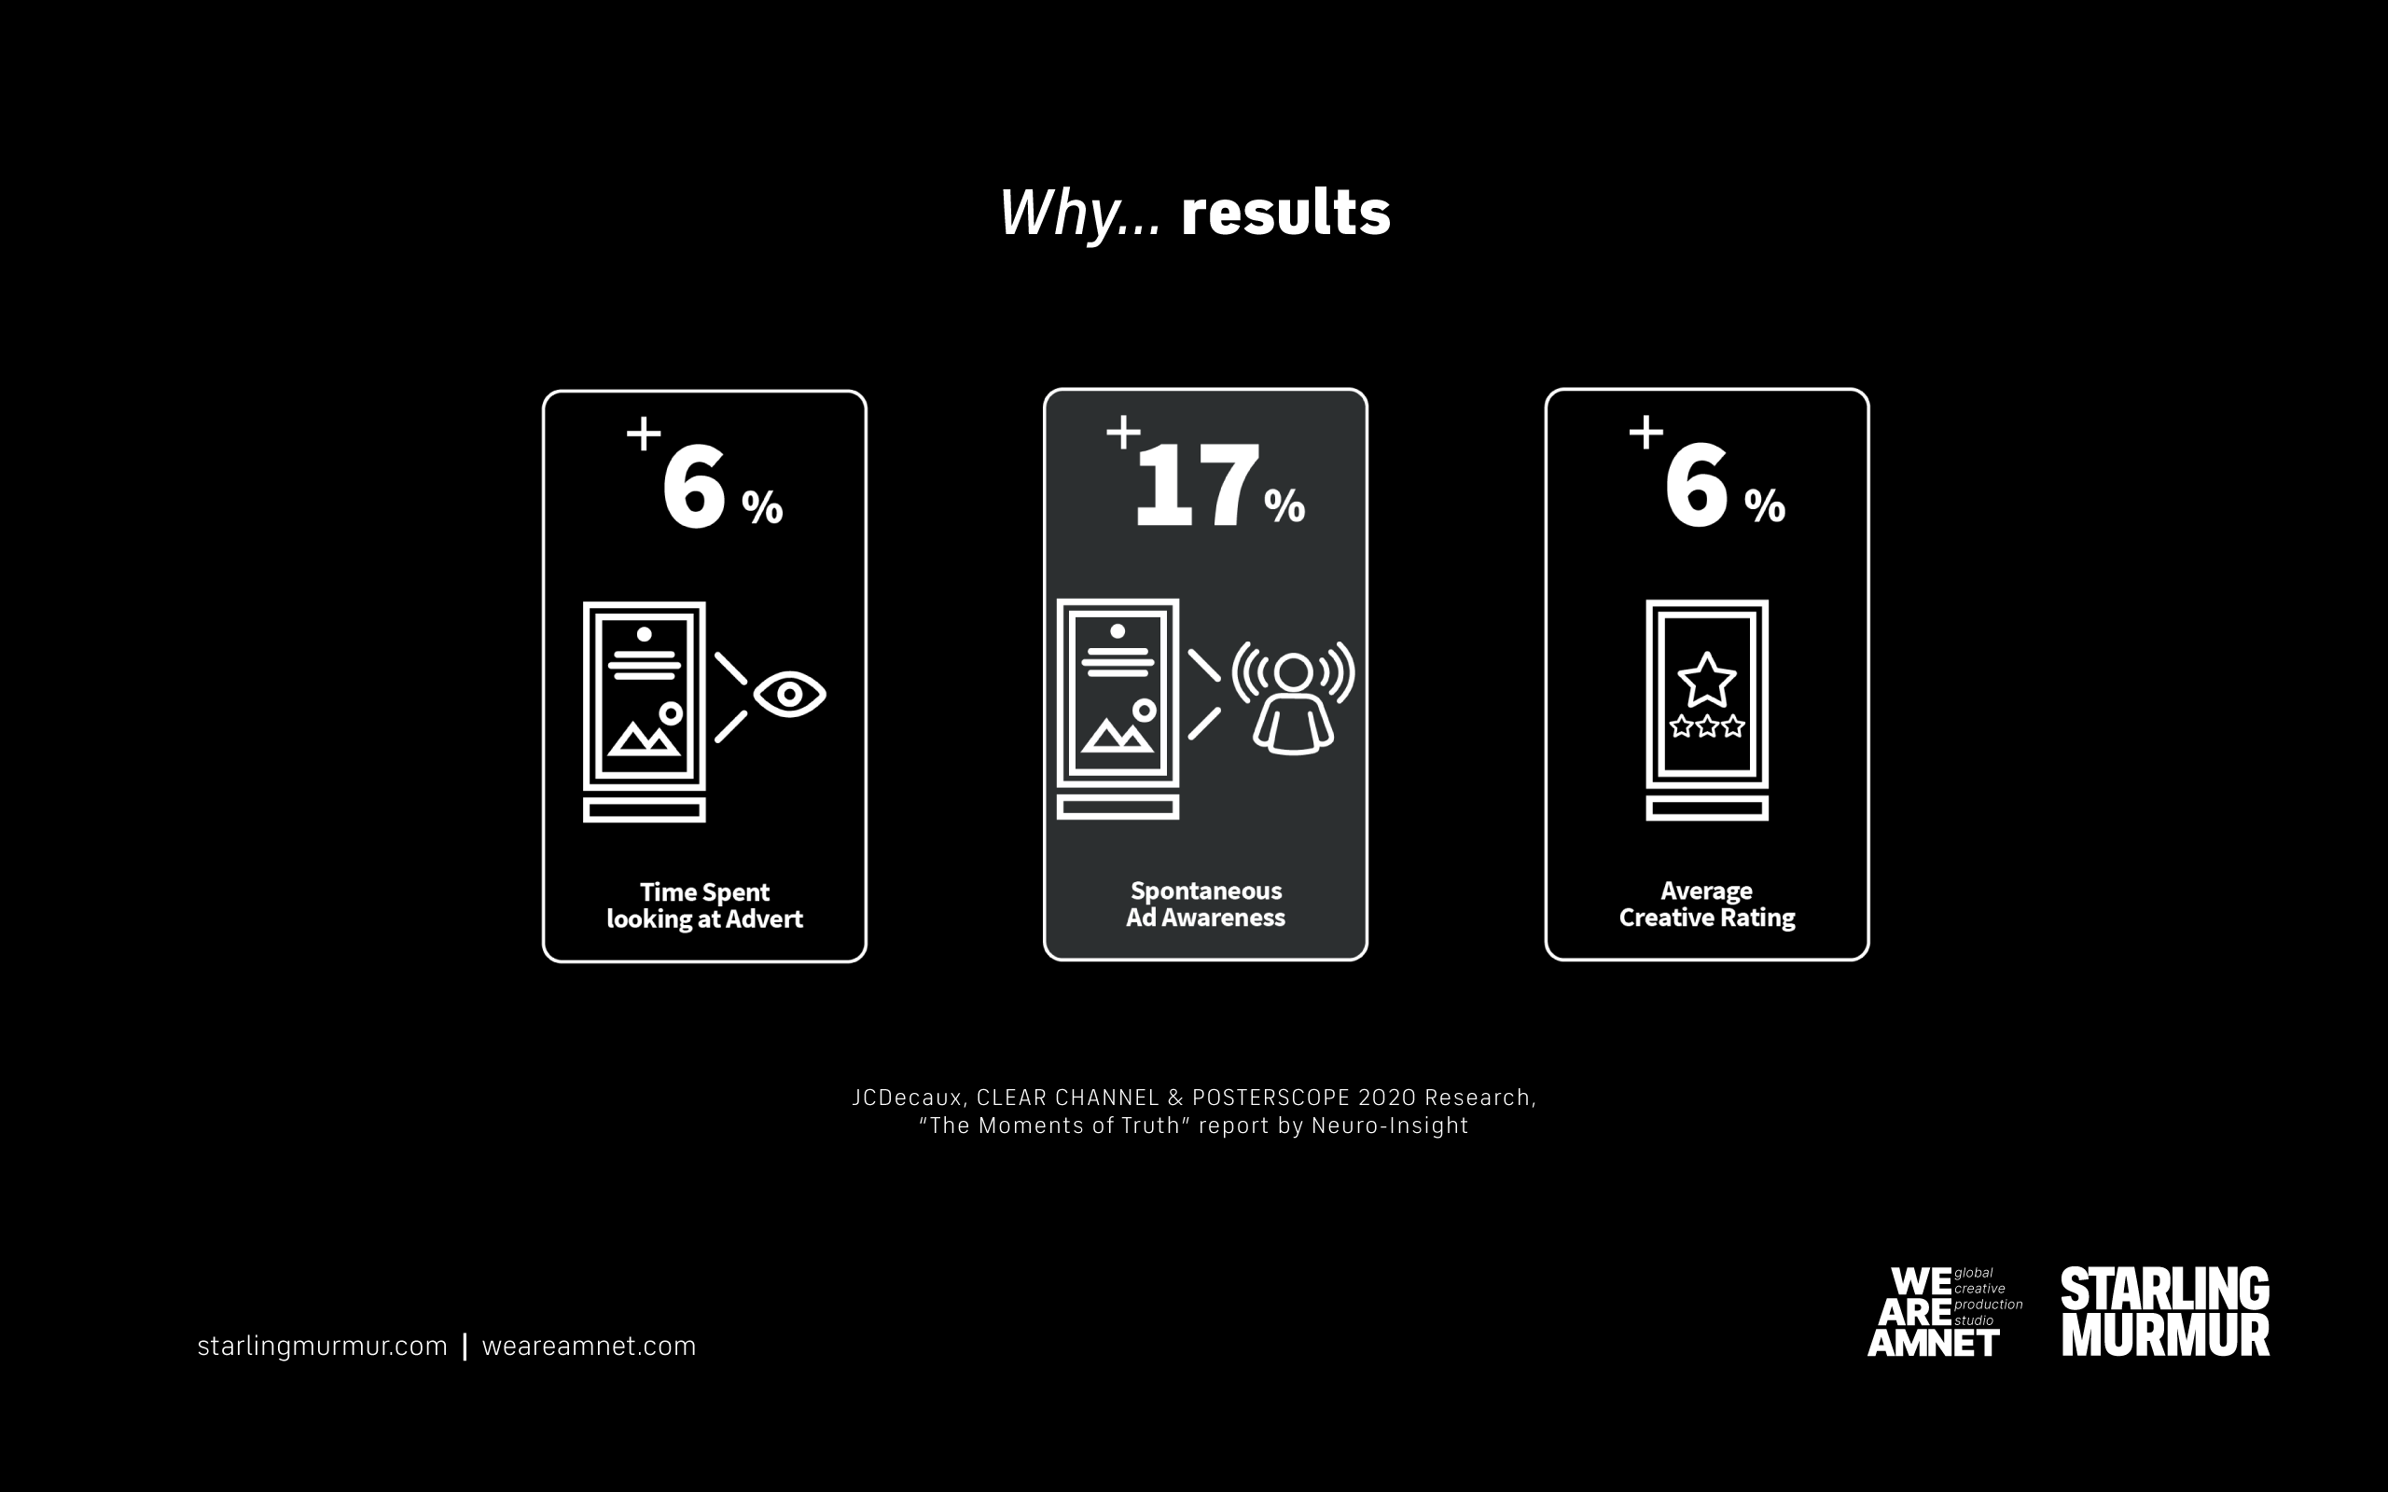
Notes:
Spontaneous Ad Awareness (or Unaided) defined as a measure of how many respondents – expresses in a percentage – ie can quote an advert’s content without any assistance.
A 2020 by Monetate and Econsultancy concluded that UK marketers reported a 26% increase in conversion rates from real-time marketing.
Available to all - media owners, brands, creative agencies, media planners, and more.
Relevant messaging that is tailored to your audience's wants, interests, and needs.
Greater retention of customer attention.
Greater speed to market and decision making
Data driving content creation
Rules based amends suited to market trend

Slide 8
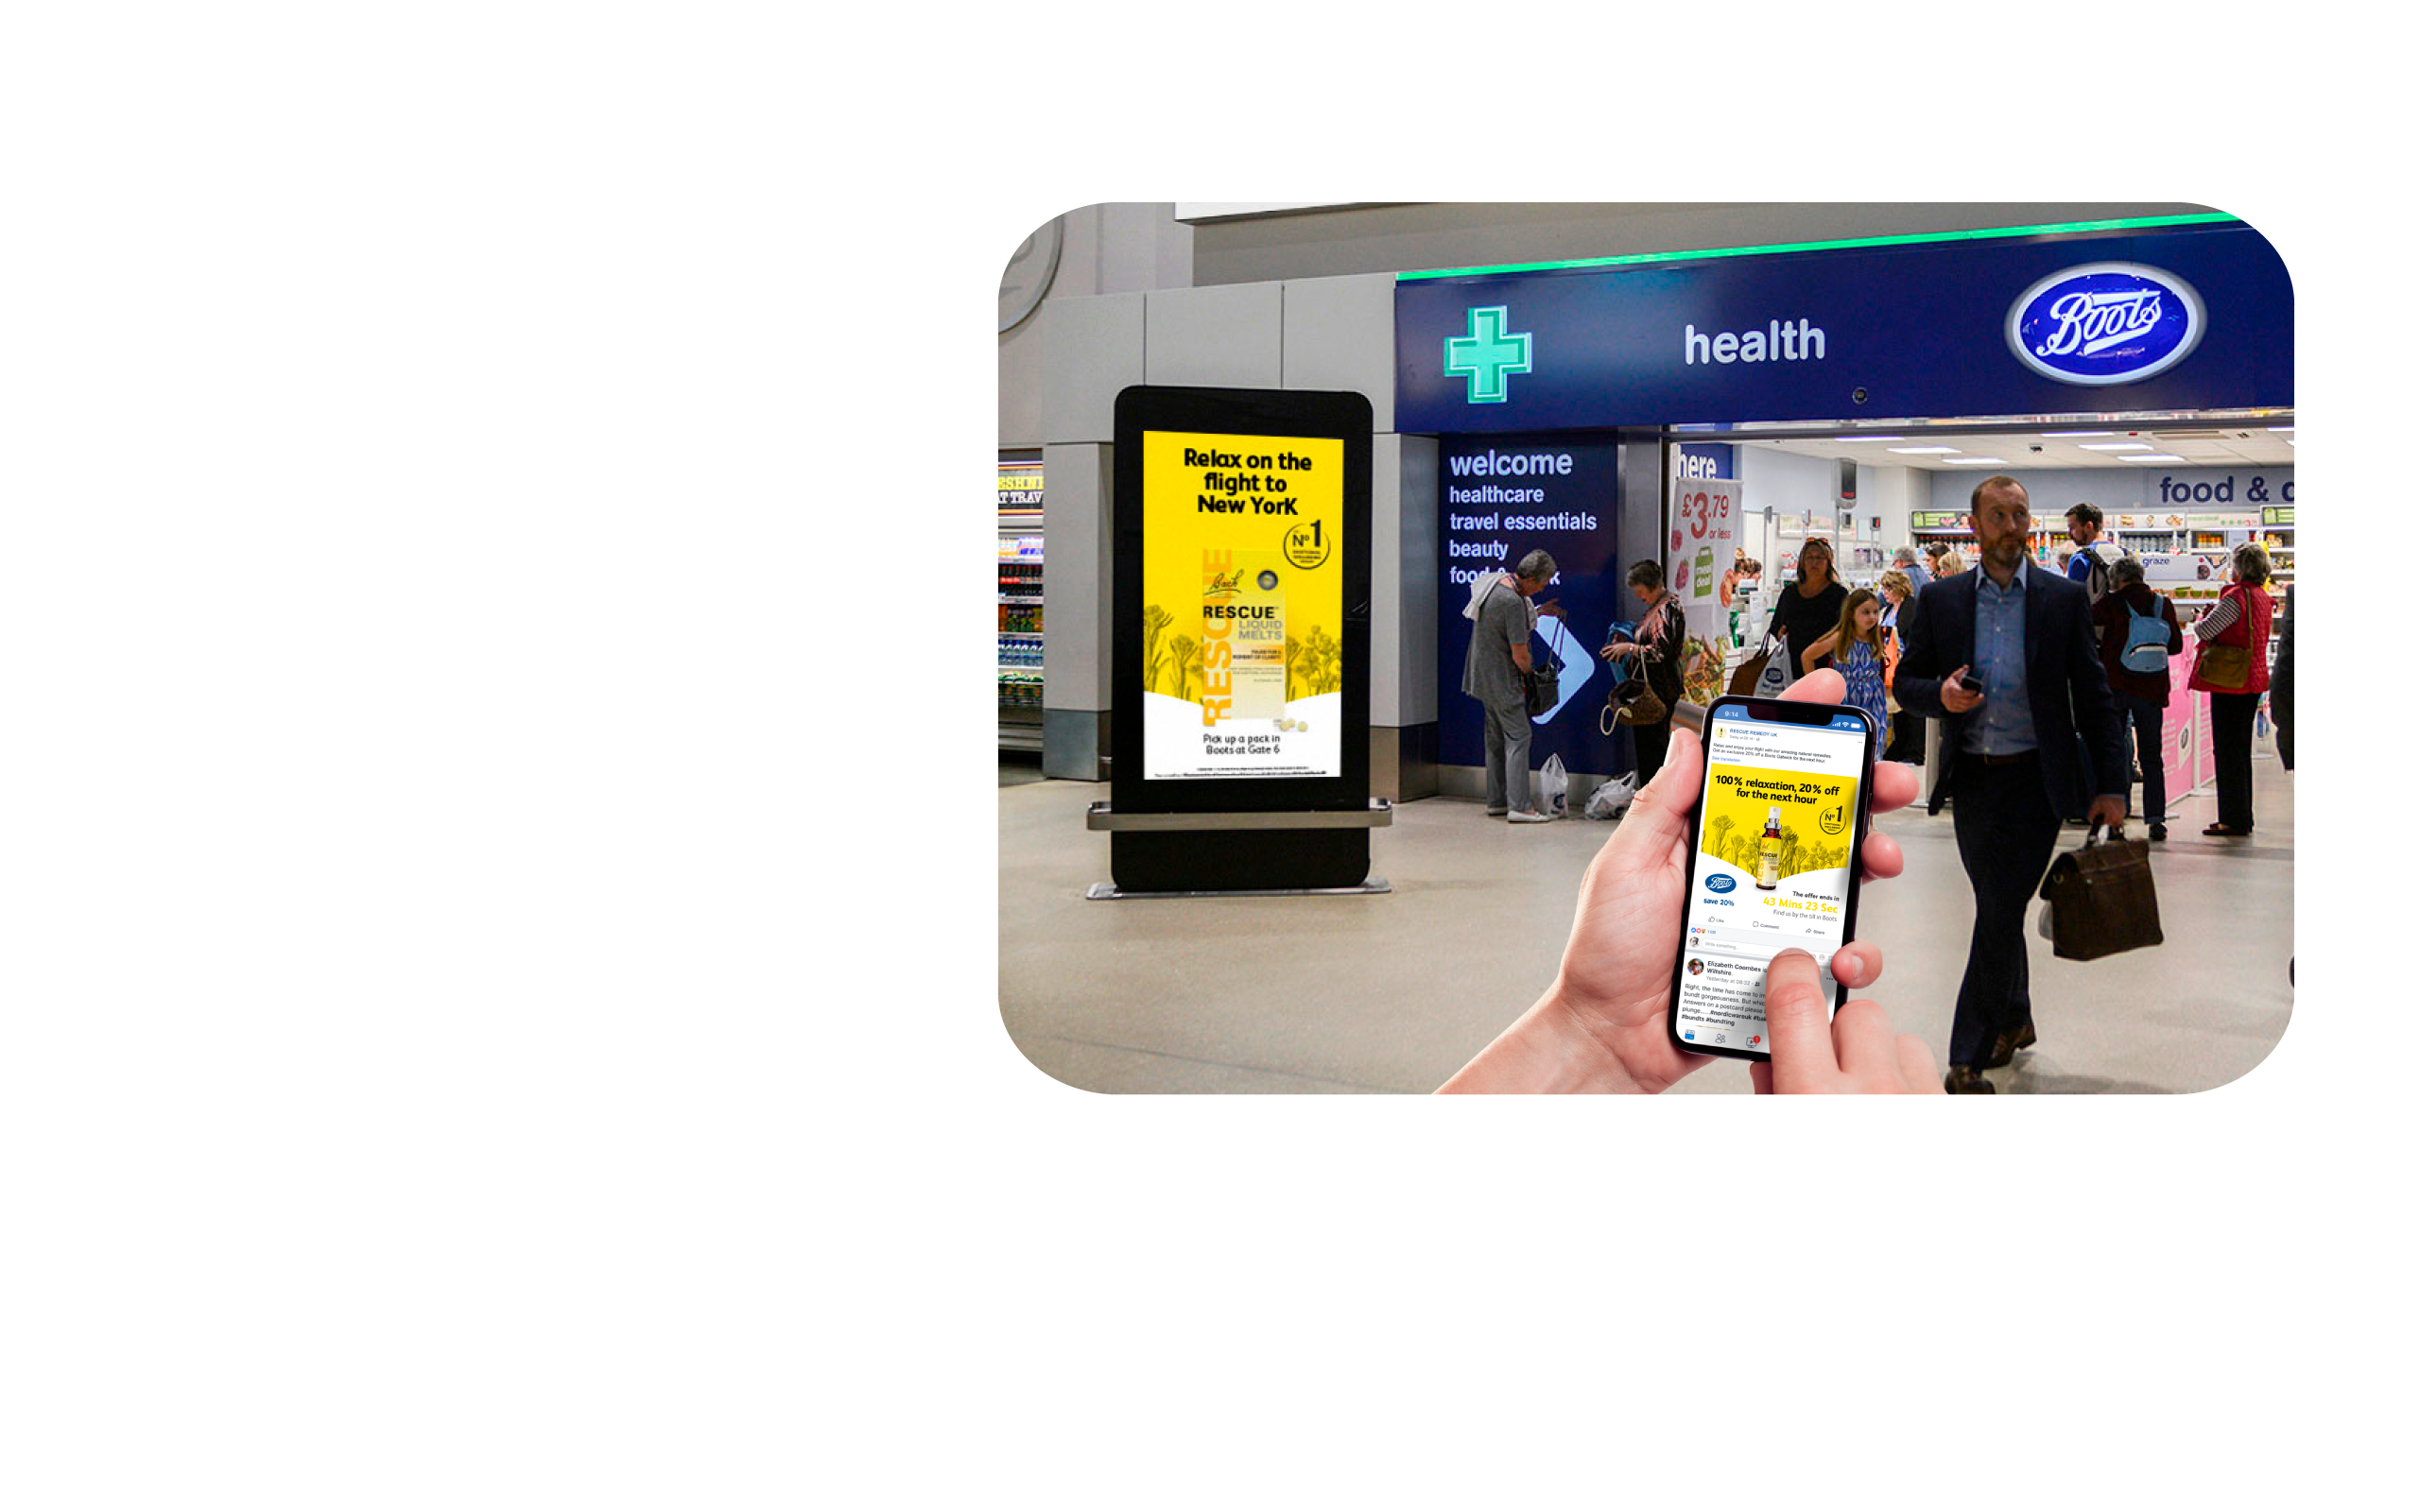

Slide 10
